Slide 1

Experiment 1: Symphony of Lights
Navarro, Rod Geryk C.
CPE160P - 4– A1

Slide 2
OBJECTIVES
To be able to demonstrate how an Arduino Kit will be used to implement the Symphony of Lights.
To be able to demonstrate that the unique chosen music can be synchronized
with the series of LEDs.
To be able to apply what you have learned in Microprocessor and Logic Circuits and Switching Theory.
To be able to apply an embedded system using an Arduino Kit.

Slide 3
MATERIALS
Arduino Kit
8 LEDs
8 220k ohm Resistors
4 10k ohm Resistors
4 Buttons
Breadboard
Arduino Uno
Laptop

Slide 4
MUSIC USED
limang Taon – Juan Karlos
Huwag na Huwag Mong Sasabihin – Lola Amour (version)
Para sa Streets – Hev Abi

Slide 5
PROCEDURE
Choose 3 songs to synchronize the symphony of lights with.
Create a working LED circuit using Arduino.
Create light patterns in the Arduino IDE.
Debug the code
Listen to music and use the patterns to create the symphony of lights.

Slide 6
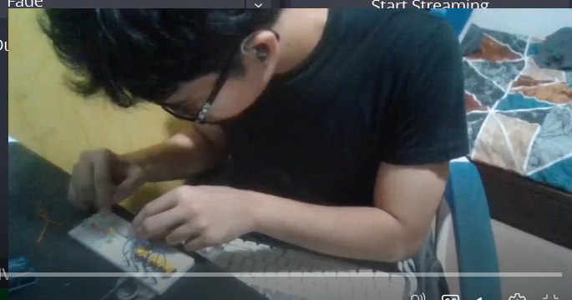
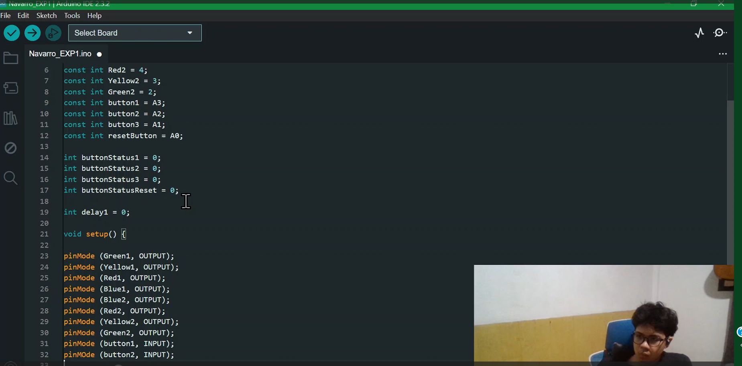
PROCEDURE

Slide 7
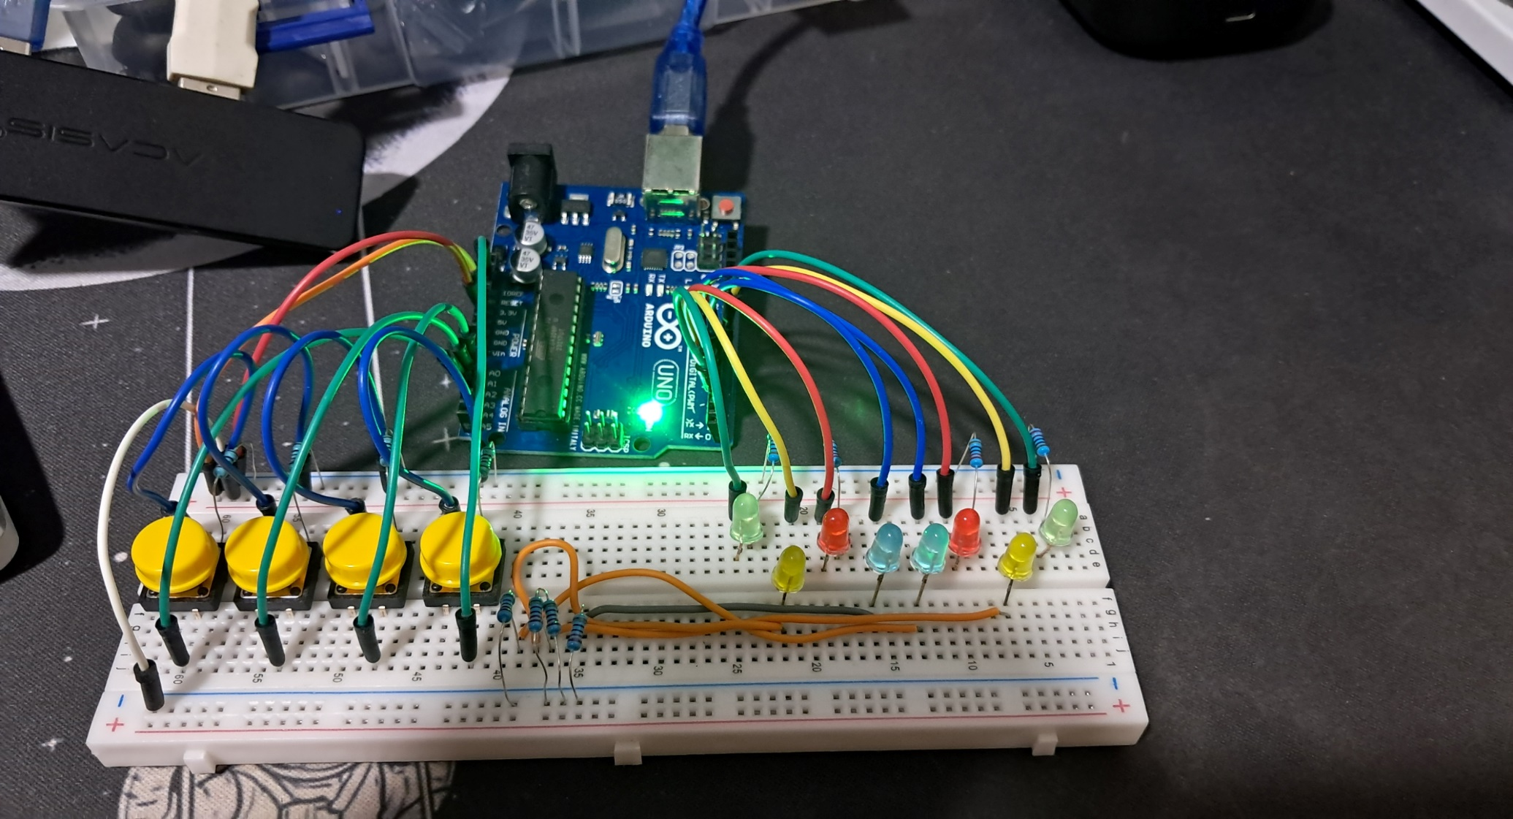
FINAL OUTPUT

Slide 8
THANK YOU!

